Slide 1
SCRUM PRIMER By Pete Deemer and Gabrielle Benefield
PREPARED AND COMPILED
BY
USMAN WAHEED

Slide 2
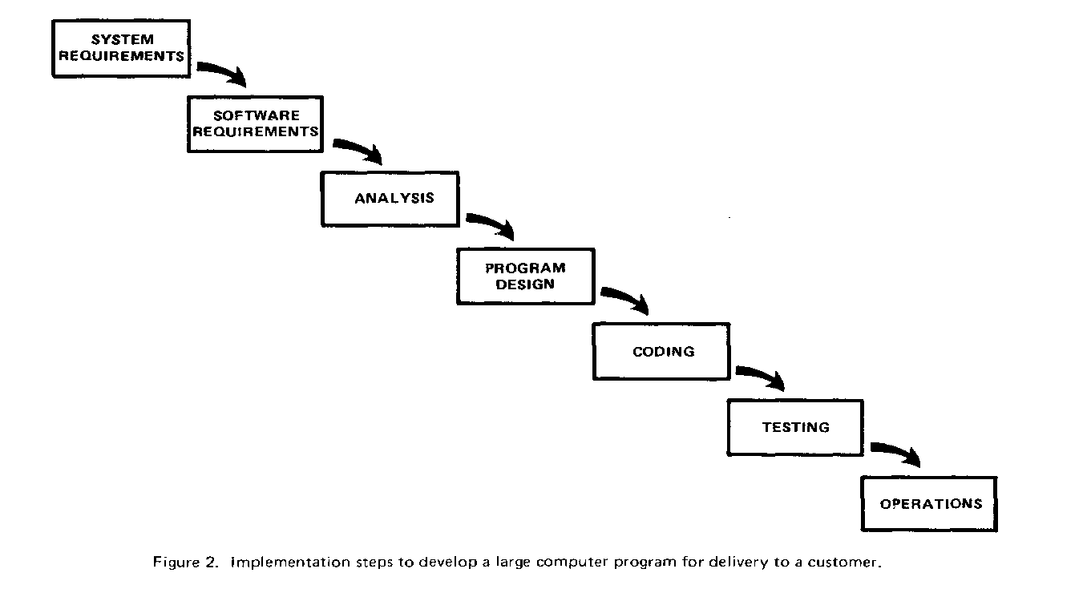
The Waterfall Model
A more grandiose approach to software development is illustrated in Figure 2.
I have experienced
different degrees of success with respect to arriving at an operational state, on-time, and within costs.
Dr. Winston W. Royce – Managing The Development Of Large Software Systems
Proceedings of IEEE WESCON 26 - 1970

Slide 3
Agile Development and Scrum
Agile emphasizes building working software that people can get hands on with quickly, versus spending a lot of time writing specifications up front.
Agile focuses on small, cross-functional teams empowered to make decisions, versus big hierarchies and compartmentalization by function,.
Agile focuses on rapid iteration, with as much customer input along the way as possible.

Slide 4
fastest-growing Agile method
One of the fastest-growing Agile methods is Scrum.
It was formalized over a decade ago by Ken Schwaber and Dr. Jeff Sutherland, and it’s now being used by companies large and small, including
Yahoo!,
Microsoft,
Google,
Lockheed Martin,
Motorola,
SAP,
Cisco,
GE Medical,
CapitalOne and
the US Federal Reserve.

Slide 5
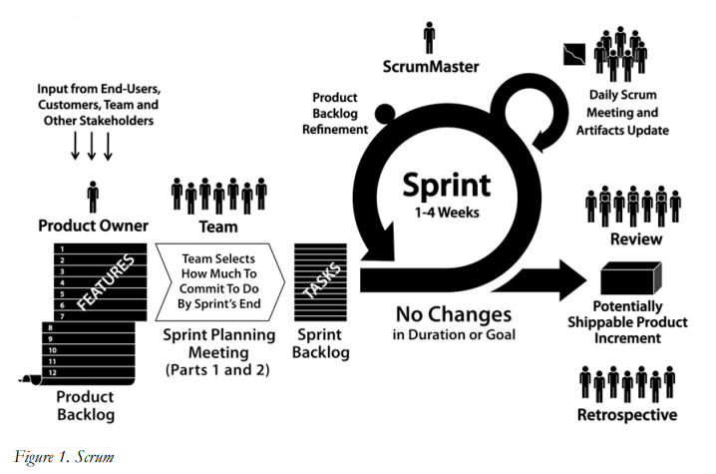

Slide 6
Quiz
List roles
List Meetings
List documents

Slide 7
Scrum
Scrum is an iterative, incremental process. Scrum structures product development in cycles of work called Sprints, iterations of work which are typically 1-4 weeks in length.
The Sprints are of fixed duration – they end on a specific date whether the work has been completed or not, and are never extended.
At the beginning of each Sprint, a cross-functional team selects items from a prioritized list of requirements, and commits to complete them by the end of the Sprint.
Each work day, the team gathers briefly to report to each other on progress, and update simple visual representations of work remaining.
At the end of the Sprint, the team demonstrates what they have built, and gets feedback which can then be acted upon in the next Sprint.
Scrum emphasizes producing working product that at the end of the Sprint is really “done”; in the case of software, this means code that is fully tested and potentially shippable.

Slide 8
Scrum Roles
In Scrum, there are three primary roles:
The Product Owner
Team Members
The ScrumMaster

Slide 9
Product Owner
The Product Owner is responsible for taking all the inputs into what the product should be – from the customer or end-user of the product, as well as from Team Members and stakeholders – and translating them into a product vision.

Slide 10
Product Owner
In some cases, the Product Owner and the customer are one and the same; in other cases, the customer might actually be millions of different people with a variety of needs.
The Product Owner role maps to the Product Manager or Product Marketing Manager position in many organizations.
Product owner is responsible for product backlog, manages release plan, adjusts priorities based on ROI and business value, accepts or rejects work results.

Slide 11
Team Members
Team Members build the product that the customer is going to consume: the software, the website, or whatever it may be.
The team in Scrum is typically five to ten people, although teams as large as 15 and as small as 3 commonly report benefits.
The team should include all the expertise necessary to deliver the finished work – so, for example, the team for a software project might include roles ( programmers, interface designers, testers, marketers, and researchers).
Projects with more than 15 people are organized as multiple Scrum teams, each focused on a different aspect of the product development, with close coordination of their efforts. While team members can split their time with other projects,

Slide 12
Team members
Team members build the product, but they also provide input and ideas to the Product Owner about how to make the product as good as it can be.
it’s much more productive to have team members fully dedicated to the Scrum. Team members can also change from one Sprint to the next, but that also reduces the productivity of the team.
Team is self-organizing, cross-functional, empowered, collocated, committed, not more than 9 people.

Slide 13
Scrum Master
The Scrum Master is tasked with doing whatever is necessary to help the team be successful.
The Scrum Master is not the manager of the team; he or she serves the team, by helping remove blocks to the team’s success, facilitating meetings, and supporting the practice of Scrum.
Some teams will have someone dedicated fully to the role of Scrum Master, while others will have a team member play this role (carrying a lighter load of regular work when they do so).

Slide 14
Scrum Master
Great Scrum Masters have come from all backgrounds and disciplines: Project Management, Engineering, Design, Testing.
The Scrum Master and the Product Owner probably shouldn’t be the same individual; at times, the Scrum Master may be called upon to push back on the Product Owner (for example, if they try to introduce new requirements in the middle of a Sprint).
And unlike a Project Manager, the ScrumMaster doesn’t tell people what to do or assign tasks – they facilitate the process, to enable the team to organize and manage itself.
Scrum master is referee, coach, facilitator, impediment remover, protector of the team.

Slide 15
Product Backlog
The first step in Scrum is for the Product Owner to articulate the product vision.
This takes the form of a prioritized list of what’s required, ranked in order of value to the customer and business, with the highest value items at the top of the list. This is called the Product Backlog, and it exists (and evolves) over the lifetime of the product (figure 2).

Slide 16
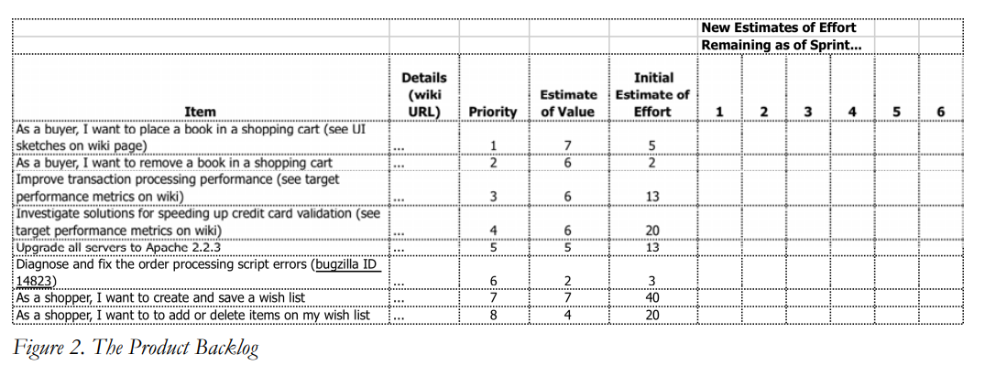
Example

Slide 17
Product Backlog…
The Product Backlog will include a variety of items, such as
features (“enable all users to place book in shopping cart”),
development requirements (“rework the transaction processing module to make it scalable”),
exploratory work (“investigate solutions for speeding up credit card validation”),
and known bugs (“diagnose and fix the order processing script errors”).
The Product Backlog is regularly updated by the Product Owner to reflect changes in the needs of the customer, announcements by the competition, new ideas or insights, technical hurdles that appear, and so forth.

Slide 18
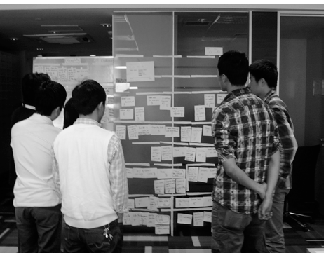

Slide 19
Product Backlog…
Product Backlog is the single, definitive view of “everything that needs to be done.” Only a single Product Backlog exists; this means the Product Owner is required to make prioritization decisions across the entire spectrum of work to be done.
Items in the Product Backlog will vary widely in size; the larger ones will often be broken into smaller pieces during the Sprint Planning Meeting, and the smaller ones may be consolidated.
One of the myths about Scrum is that it prevents you from writing detailed specifications; in reality, it’s up to the Product Owner and Team to decide just how much detail is required, and this may vary from one Product Backlog item to the next.

Slide 20
Sprint Planning Meeting
In the first part of the Sprint Planning Meeting, the Product Owner and Scrum Team (with facilitation from the Scrum Master) review the Product Backlog, discussing the goals and context for the items on the Backlog, and providing the Scrum Team with insight into the Product Owner’s thinking.
In the second part of the meeting, the Scrum Team selects the items from the Product Backlog to commit to complete by the end of the Sprint, starting at the top of the Product Backlog (in others words, starting with the items that are the highest priority for the Product Owner) and working down the list in order.
This is one of the key practices in Scrum: the team decides how much work they will commit to complete, rather than having it assigned to them by the Product Owner. This makes for a much more reliable commitment;

Slide 21
Sprint Planning Meeting
The Sprint Planning meeting will often last a number of hours
the team is making a very serious commitment to complete the work, and this commitment requires careful thought to be successful.
The team will begin by estimating how much time each member has for Sprint-related work – in other words, their average workday minus the time they spend doing things like critical bug-fixes and other maintenance, attending meetings, doing email, taking lunch breaks, and so on. For most people this works out to 4-6 hours of time per day available for Sprint-related work. (Figure 3.)

Slide 22
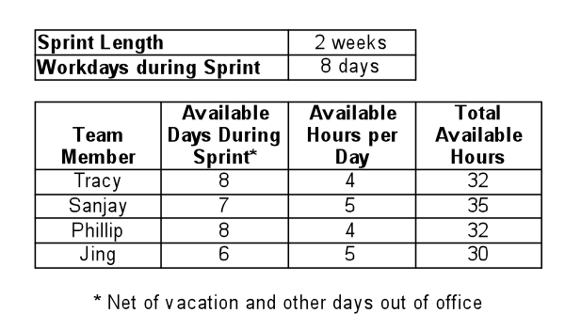
Sprint planning

Slide 23
Sprint backlog
Once the time available is determined, the team starts with the first item on the Product Backlog
In other words, the Product Owner’s highest priority item – and working together, breaks it down into individual tasks, which are recorded in a document called the Sprint Backlog (figure 4).
At the end of the meeting, the team will have produced a list of all the tasks, and for each task who has signed up to complete it and how much time they estimate it will take (typically in hours or fractions of a day).

Slide 24
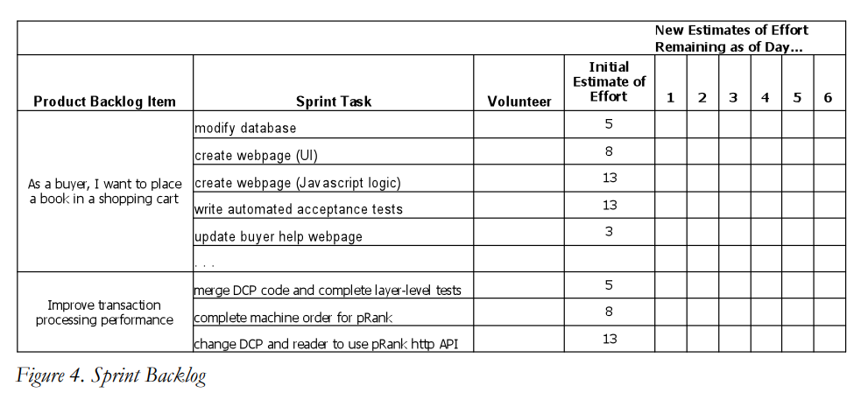
Example

Slide 25
Scrum Change
One of the key pillars of Scrum is that once the Scrum Team makes its commitment, the Product Owner cannot add new requests during the course of the Sprint.
This means that even if halfway through the Sprint the Product Owner decides that they want to add something new, he or she cannot make changes until the start of the next Sprint.
If an external circumstance appears that significantly changes priorities, and means the team would be wasting its time if it continued working, the Product Owner can terminate the Sprint;
this means the team stops all the work they are doing, and starts over with a Sprint Planning meeting, and so forth.

Slide 26
Daily Standup Meeting
Once the Sprint has started, the Scrum Team engages in another of the key Scrum practices: The Daily Stand-Up Meeting.
This is a short (15 minute) meeting that happens every workday at an appointed time, and everyone on the Scrum Team attends; in order to ensure it stays brief, everyone stands (hence “Stand-Up Meeting”).
It’s the team’s opportunity to report to itself on progress and obstacles.
One by one, each member of the team reports just three things to the other members of the team:
What they were able to get done since the last meeting.
what they’re aiming to get done by the next meeting.
any blocks or obstacles that are in their way.
There’s no discussion during the Daily Stand-Up Meeting, just the reporting of the three key pieces of information; if discussion is required, it takes place right after the meeting.

Slide 27
Role of participants during meeting
The Scrum Master makes note of the blocks, and then helps team members to resolve them after the meeting.
The Product Owner, Managers, and other stakeholders can attend the meeting, but they should refrain from asking questions or opening discussion until after the meeting concludes
everyone should be clear that the team is reporting to each other, not to the Product Owner, Managers or Scrum Master.
While it’s non-standard, some teams find it useful to have the Product Owners join and give a brief daily report of their own activities to the team.

Slide 28
After meeting
After the meeting, the team members update the amount of time remaining to complete each of the tasks that they’ve signed up for on the Sprint Backlog.
The important thing is that it show the team their actual progress towards their goal – and not in terms of how much time has been spent so far (an irrelevant fact, as far as Scrum is concerned), but in terms of how much work remains – what separates the team from their goal.
If the curve is not tracking towards completion at the end of the Sprint, then the team needs to either pick up the pace, or simplify and cut down what it’s doing.

Slide 29
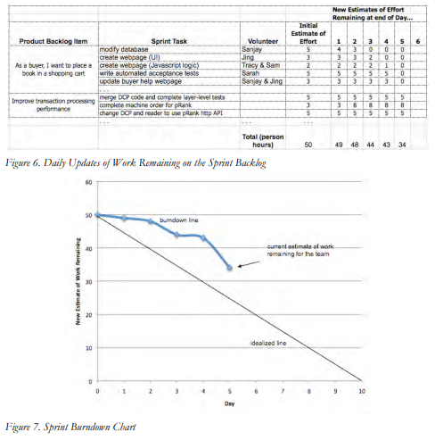
This information is recorded on a graph called the Sprint Burndown Chart (figure 5). It shows, each day, how much work (measured in hours or days) remains until the team’s commitment is completed. Ideally, this should be a downward sloping graph that is on a trajectory to hit zero on the last day of the Sprint. And while sometimes it looks like that, often it doesn’t.

Slide 30
Sprint status
One of the core principles of Scrum is that the duration of the Sprint is never extended – it ends on the assigned date regardless of whether the team has completed the work it committed to or not.
If the team has not completed their Sprint Goal, they have to stand up at the end of the Sprint and acknowledge that they did not meet their commitment.
The idea is that this creates a very visible feedback loop, and teams are forced to get better at estimating what they are capable of accomplishing in a given Sprint, and then delivering it without fail.

Slide 31
Sprint status
Teams will typically over-commit in their first few Sprints and fail to meet their Sprint Goal; they might then overcompensate and under commit, and finish early; but by the third or fourth Sprint, teams will typically have figured out what they’re capable of delivering, and they’ll meet their Sprint goals reliably after that.
Teams are encouraged to pick one duration for their Sprints (say, 2 weeks) and not change it frequently – a consistent duration helps the team learn how much it can accomplish, and it also helps the team achieve a rhythm for their work (this is often referred to as the “heartbeat” of the team).

Slide 32
Sprint Review
After the Sprint ends, there is the Sprint Review, where the team demos what they’ve built during the Sprint.
Present at this meeting are the Product Owner, Team Members, and Scrum Master, plus customers, stakeholders, experts, executives, and anyone else interested.
This is not a “presentation” the team gives – there are no PowerPoints, and typically no more than 30 minutes is spent preparing for it – it’s literally just a demo of what’s been built, and anyone present is free to ask questions and give input.
It can last 10 minutes, or it can last two hours – whatever it takes to show what’s been built and get feedback

Slide 33
Sprint Retrospective
Following the Sprint Review, the team gets together for the Sprint Retrospective.
It’s an opportunity for the team to discuss what’s working and what’s not working, and agree on changes to try.
The Scrum Team, the Product Owner, and the ScrumMaster will all attend, and a neutral outsider will facilitate the meeting; a good approach is for Scrum Masters to facilitate each others’ retrospectives, which enables cross-pollination among teams.
This is a practice that some teams skip, and that’s unfortunate because it’s one of the most important tools for making Scrum successful.

Slide 34
Sprint status
A simple way to structure the Sprint Retrospective is to hang two sheets of poster-sized paper labeled “What’s Working Well” and “What’s Not Working, or Could Work Better” – and then have each person add several items to either.
As items are repeated, check-marks are added next to them, so the common items become clear. Then the team looks for underlying causes, and agrees on changes to make in the upcoming Sprint, along with a commitment to review the results at the next Sprint Retrospective.

Slide 35
Starting the Next Sprint
Following the Sprint Review Meeting, the Product Owner takes all the input, as well as all new priorities that have appeared during the Sprint, and incorporates them into the Product Backlog; new items are added, and existing ones are modified, reordered, or deleted.
Once this updating of the Product Backlog is complete, the cycle is ready to begin all over again, with the next Sprint Planning Meeting.
One practice many teams find useful is to hold a Prioritization Meeting toward the end of each Sprint, to review the Product Backlog for the upcoming Sprint with the Product Owner.
In addition to giving the team an opportunity to suggest items the Product Owner may not be aware of – technical maintenance, for example – this meeting also kicks off any preliminary thinking that’s required before the Sprint Planning Meeting.
There’s no downtime between Sprints – teams will often go from a Sprint Review one afternoon into the next Sprint Planning Meeting the following morning.
One of the values of Agile development is “sustainable pace”, and only by working regular hours at a reasonable level of intensity can teams continue this cycle indefinitely.

Slide 36
Release Planning
Sprint(s) continue until the Product Owner decides the product is almost ready for release, at which point there may be a “Release Sprint” to do final integration and testing in preparation for launch. If the team has followed good development practices along the way, with continuous refactoring and integration, and effective testing during each Sprint, there should be little cleanup required.

Slide 37
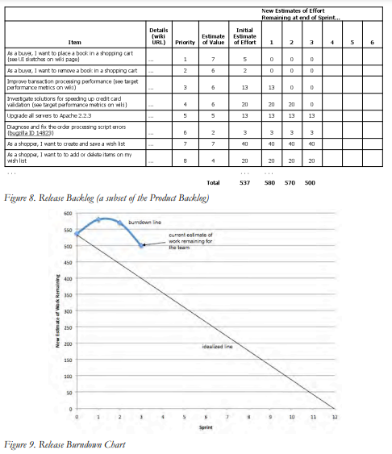

Slide 38
